Slide 1
Beat-Sync-Mash-Coder
A web application for real-time creation of beat-synchronous music mashups by Garth Griffin, Youngmoo E. Kim and Douglas Turnbull
Interactive Music – 2018/2019
Vítor Emanuel Fernandes Magalhães - up201503447

Slide 2
Objective of the paper
Present a tool for semi-automated real-time creation of beat-synch music mashups.
By automating the task of synchronizing clips, the user is freed from this responsibility, allowing the replacement of traditional audio editing with an intuitive clip selection interface.
Web-based and operates in a Flash framework.

Slide 3
What is new?
Breaks paradigm of traditional Digital Audio Workstation (DAW) through novel use of two Digital Signal Processing (DSP) technologies:
Beat-tracking
Phase vocoding
This novel use over the web brings cutting-edge technology to anyone interested in creating mashups.
Notes:
Mashup requires locating source, cut up and spliced together. And every clip must be synchronized. Since creating mashups is a time-consuming tasks, the intent of the tool is to provide a faster way to do this.
One of two ways to create mashups:
1st: combining very small units of sound (100-200ms) into an audio collage. User specifies audio output and computer chooses samples and constructs the waveform.
Limits control and restricts creativity.
2nd: user manually splices and layers the raw using a Digital Audio Workstation.
A DAW is a digital version of the analog mixing board used in recording studios.
DAW may be powerful, but combining tracks is a bore.

Slide 4
Approach
The system uses DSP to combine clips in a musically meaningful way.
Most web apps require powerful servers to run intensive DSP and use C as the native language. This lacks the scalability of performing in the user’s computer.
Problem: Web Development frameworks add substantial overhead, reducing how much DSP can be done in the client.
Solution: Use Adobe’s Alchemy framework, which optimizes C code compilation.
Notes:
Alchemy allows C code to be compiled to optimized bytecode that can be executed in Flash.
Essentially, this provides the power of C without performance loss, enabling all DSP on client side.

Slide 5
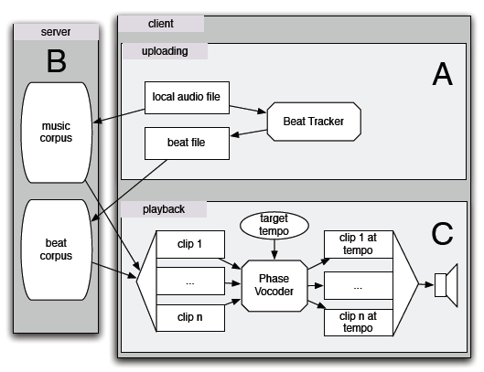
System Design
Beat Tracker(A).
Phase Vocoder(C);
A and C are client side and B is server side
Notes:
User starts by adding clips in A, the info is stored in B and C is the mashup tool itself

Slide 6
Beat Tracker
It is configured to work with any beat tracking algorithm, but it was implemented based on a technique developed by Scheirer.
Other techniques (Ellis and Jehan based, with the latter being available through EchoNest as an API) were also tested in the system.
Notes:
System must synchronize beats of every clip during playback to ensure the overall output is perceived as musically coherent. Beat tracker is modular.
1st implementation approach was based in dynamic programming.
Scheirer’s implemenation uses a large comb of filters.

Slide 7
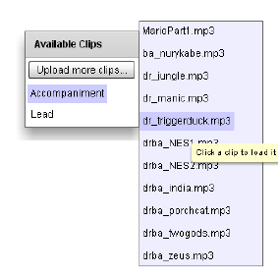
Music and Beat Corpora
Two category groups of clips: Lead Parts (solo vocal tracks) and Accompaniment Parts (drum and bass tracks)
User selects clip and indicates category
The clip is analyzed via Beat Tracker
Both the clip and the beat tracker information is uploaded to server, which is available to anyone.

Slide 8
Phase Vocoder
Phase Vocoding enables pitch-invariant time-scaling, allowing tempo changes of each clip to match the user’s target during playback.
Implementation consists of altering phases of specific ranges in the frequency domain. The pitch-invariant time-shifting can be combined with resampling for pitch-invariant time-scaling.
System also allows real-time control by operating incrementally. This is done by computing enough output to the buffer and overlapping and adding every frame with its predecessors, allowing interruption and resumption without data loss.

Slide 9
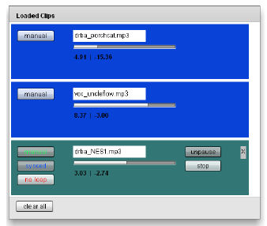
Playback
The user can: choose each clip, instruct the system to randomly choose a number of each type of clip or have a mix of manually and automatically selected clips.
The system computes output audio incrementally with a 4096 sample buffer.
The system keeps track of the time since the last beat, L. The tempo value by the user helps calculate beat length, B. A= L/B is how much of the current beat has already played.
Loaded clips are displayed with status
Notes:
Increasing the length of the buffer would result in more efficient computation but also increase the latency associated with changing parameters

Slide 10
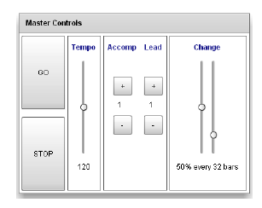
Playback
For each clip, the system keeps track of the last played beat and calculates the timescaling ratio for each clip to be in the desired tempo.
By calculating the location of the playback within a certain clip, the phase vocoder is instructed to compute frames of said clip, with the calculated timescale, starting in the location of the playback until the buffer is filled.
The phase vocoder updates the position and, as soon as this is done for every clip, all the outputs are summed and normalized and the result is sent to output buffer.

Slide 11
Some Playback details
If the user moves the tempo slider, only B changes in the calculations.
Adding/removing clip is simply a matter of updating the clips in the calculations.
When a clip is added, it must be aligned with the clips that are playing. At the time of the writing of the paper, the authors assumed that all clips would be 4/4 time.
The system sets the playback position such that the first beat of a clip will occur at the next perceived downbeat, which either truncates some samples or pads with silence.

Slide 12
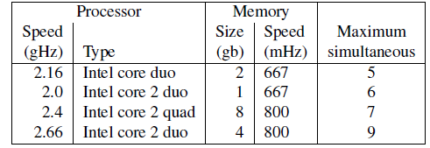
Approach Evaluation
Benchmarks: The system was tested on various processors by adding clips to the playback stream at 120 bpm until the system could no longer play the audio.
User Study: 24 high school students selected students, based on interest in music and technology.
Students praised the concept of the system and the ease of use, as well as the tempo adjust and the capability of timestretching
Performance on consumer-level hardware

Slide 13
Results
New interface for music mashup creation, by using two DSP technologies.
Users benefit of beat-tracking and real-time phase vocoding over the web.
Authors believe that the system could inspire students to pursue a new interest in music.

Slide 14
Why is this tool interesting?
This tool creates a community-based beat sync system, because it allows anyone to upload a clip, as well as the beat information, on to a server, for public use.
When working on a mashup, a user can use any clips previously added to the server.

Slide 15
Some similar tools in Pd
Pure data live sampling-mashup: https://github.com/GiantSteps/MC-Sonaar
Simple patch to mix audio signals: http://www.pdpatchrepo.info/hurleur/mixing.pd

Slide 16
What can we do with this tool?
Garth Griffin’s website points to a playable application.
Problem: The link for the playable application is dead.
Solution: Use paper as a guide to implement tool in Pure Data as an external patch. Pure data is open source and made in C. The tool was made in C as well.

Slide 17
Thank you for your time
Questions?

